Slide 1
Car Price Prediction PPT
A PowerPoint presentation containing problem statement and understanding, EDA steps and visualizations, Steps and assumptions used to complete the project, model dashboard, finalized model, and conclusion.

Slide 2
Problem Statement
With the covid 19 impact in the market, we have seen lot of changes in the car market. Now some cars are in demand hence making them costly and some are not in demand hence cheaper. One of our clients works with small traders, who sell used cars. With the change in market due to covid 19 impact, our client is facing problems with their previous car price valuation machine learning models. So, they are looking for new machine learning models from new data. We have to make car price valuation model.
we have to scrape at least 5000 used cars data. You can scrape more data as well, it’s up to you. more the data better the model
In this section You need to scrape the data of used cars from websites (Olx, cardekho, Cars24 etc.) You need web scraping for this. You have to fetch data for different locations. The number of
columns for data doesn’t have limit, it’s up to you and your creativity. Generally, these columns are Brand, model, variant, manufacturing year, driven kilometers, fuel, number of owners, location and at last target variable Price of the car. This data is to give you a hint about important variables in used car model. You can make changes to it, you can add or you can remove some columns, it completely depends on the website from which you are fetching the data.
Try to include all types of cars in your data for example- SUV, Sedans, Coupe, minivan, Hatchback.

Slide 3
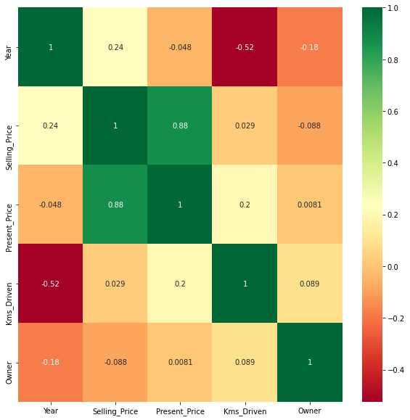
Data Visualization

Slide 4
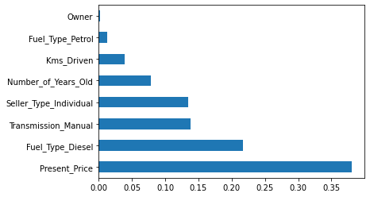

Slide 5
Model’s Training
Model’s used for the classification and regression

Slide 6
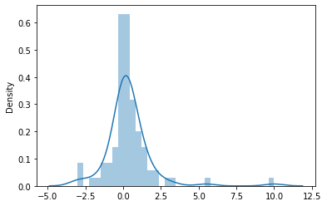
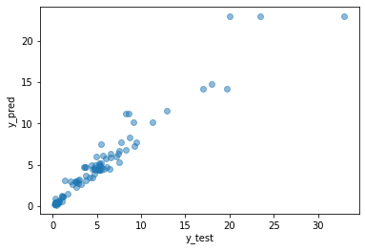
1. Decision Tree Classification Model –
Decision Tree is a Supervised learning technique that can be used for both classification and Regression problems, but mostly it is preferred for solving Classification problems. It is a tree-structured classifier, where internal nodes represent the features of a dataset, branches represent the decision rules and each leaf node represents the outcome.
In a Decision tree, there are two nodes, which are the Decision Node and Leaf Node. Decision nodes are used to make any decision and have multiple branches, whereas Leaf nodes are the output of those decisions and do not contain any further branches.
The decisions or the test are performed on the basis of features of the given dataset.
It is a graphical representation for getting all the possible solutions to a problem/decision based on given conditions.

Slide 7
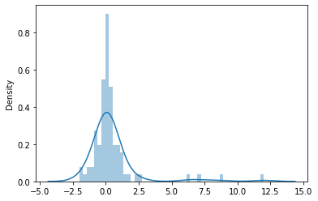
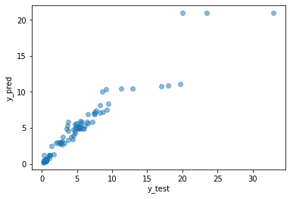
2. Random Forest Model –
Random Forest is a popular machine learning algorithm that belongs to the supervised learning technique. It can be used for both Classification and Regression problems in ML. It is based on the concept of ensemble learning, which is a process of combining multiple classifiers to solve a complex problem and to improve the performance of the model.
As the name suggests, "Random Forest is a classifier that contains a number of decision trees on various subsets of the given dataset and takes the average to improve the predictive accuracy of that dataset." Instead of relying on one decision tree, the random forest takes the prediction from each tree and based on the majority votes of predictions, and it predicts the final output.
The greater number of trees in the forest leads to higher accuracy and prevents the problem of overfitting.

Slide 8
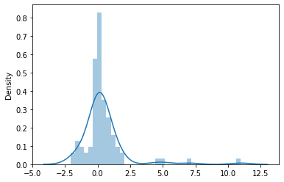
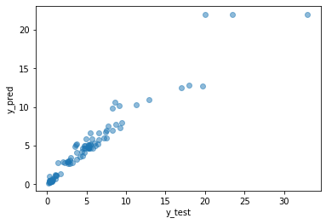
3 . Voting Regressor Model -
Voting is an ensemble machine learning algorithm. For regression, a voting ensemble involves making a prediction that is the average of multiple other regression models. ... A soft voting ensemble involves summing the predicted probabilities for class labels and predicting the class label with the largest sum probability.

Slide 9
Conclusion
So here 'Voting Regressor Model' is the best model out of all model tested above and by looking this we can conclude that our model is predicting around 7.35336698.

